Slide 1

Construction Information Meeting
WIS 35
Lanquist Street to WIS 70 East
Burnett County
March 17, 2026

Slide 2

Agenda
Project Location
Purpose and Need
Proposed Improvements
Traffic Impacts
Staying Informed
Construction Contacts

Slide 3
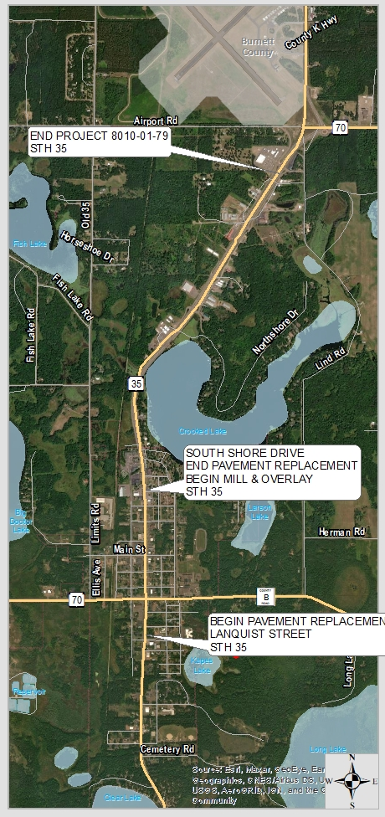
Project Location
County:
Burnett
Highway:
WIS 35
Limits:
Lanquist Street in the city of Siren to just south of the roundabout at WIS 70 East in the town of Siren

Slide 4
Purpose and Need
Purpose
Address the deteriorating pavement and flooding issues, upgrade the storm sewer and adjust guardrail
Need
Failing pavement at multiple locations
Inadequate truck access at WIS 35 and WIS 70/County B intersection

Slide 5
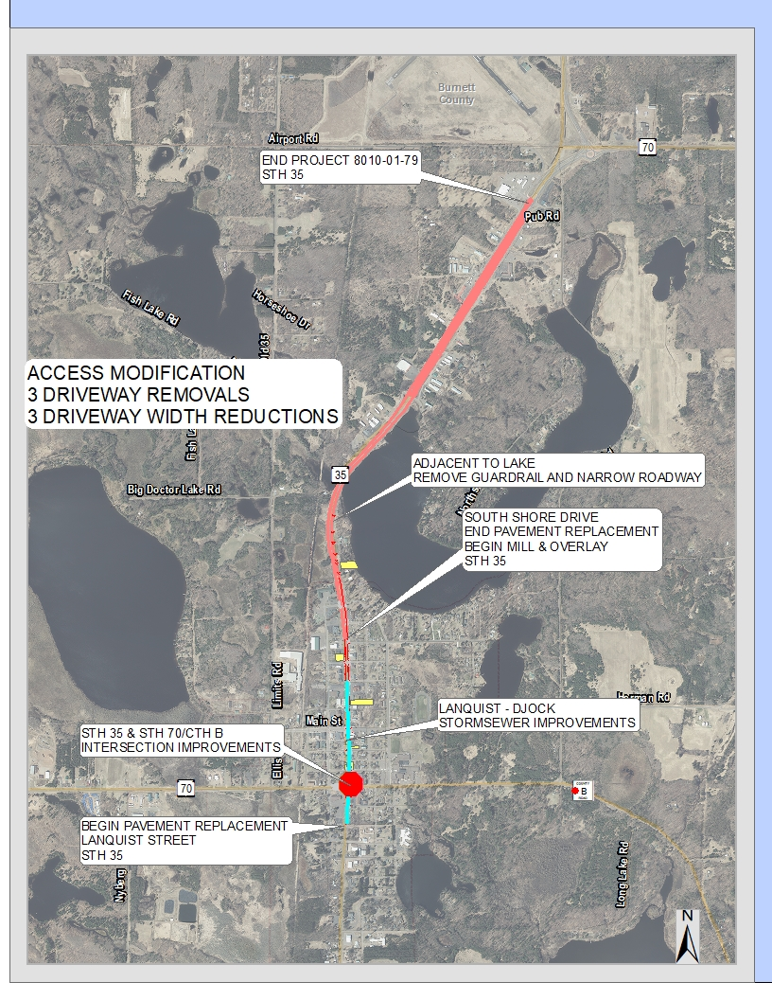
Proposed Improvements
Replace pavement with new concrete
Lanquist Street to Southshore Drive
Replace storm sewer and expand its capacity
Lanquist to Works Progress Street
Resurface the roadway
Southshore Drive to WIS 70 East
Remove extra lanes to reduce flooding potential
Park Street to Northshore Drive
Review and revise access points
WORKS PROGRESS

Slide 6
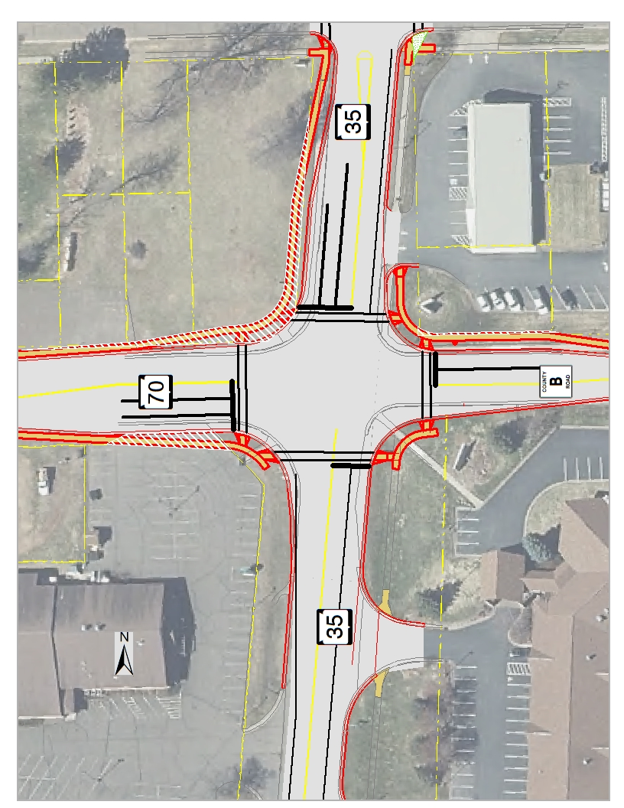



Proposed Improvements
Make improvements at the intersection of WIS 35/70
Improve turning movements in all quadrants
Replace traffic signals
Replace curb ramps
B

Slide 7
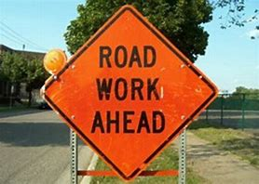
Traffic Impacts
During resurfacing from Southshore Drive to the WIS 70 East roundabout:
Motorists will encounter single-lane closures controlled by flagging or temporary signals.
During the pavement replacement from Lanquist Street to Southshore Drive:
Only southbound car traffic will be allowed, and northbound car and truck traffic will be detoured.

Slide 8
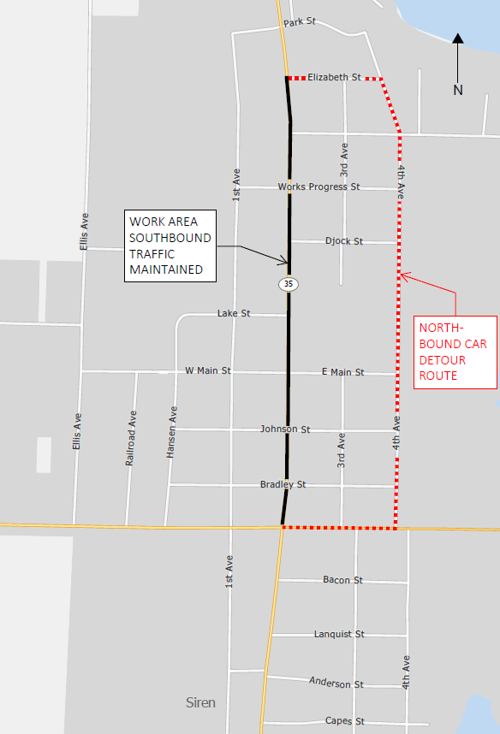
Detour Route: Cars
During the closure of WIS 35:
Southbound traffic will be maintained.
Northbound cars will be detoured via County B, 4th Avenue North and Elizabeth Street.

Slide 9
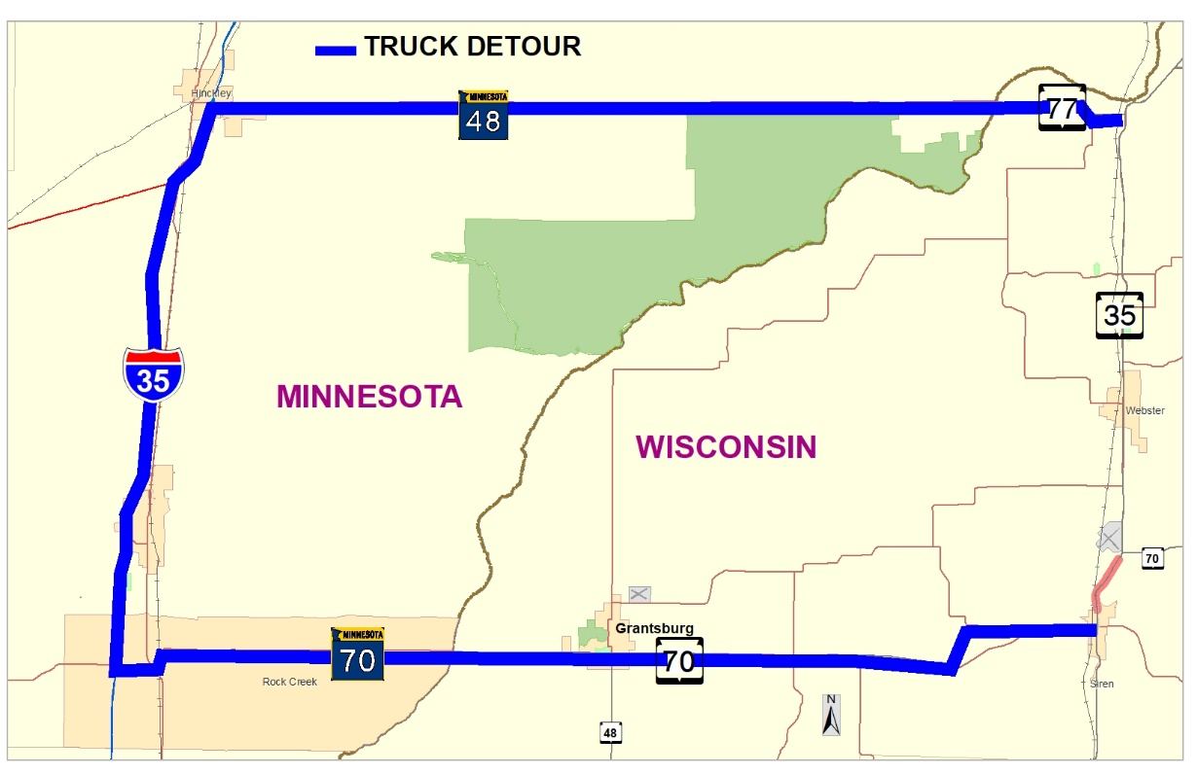
Traffic Impacts: Trucks
During the closure of WIS 35:
Trucks will be detoured via WIS 70/MN 70 to I-35 (MN) to MN 48/WIS 77 to WIS 35

Slide 10
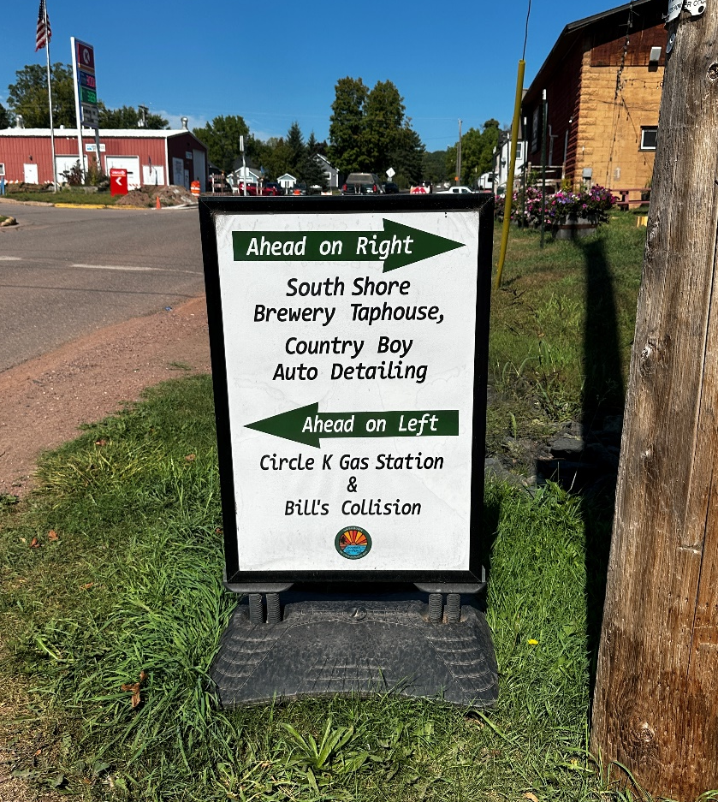
Impacts: Business
WisDOT’s In This Together program
Provides tips, tools and resources to help business owners navigate construction
Advice on how to keep employees, customers and vendors in the loop
Examples of what businesses have done in other communities
Guidance on signage
Visit wisconsindot.gov/together

Slide 11
Staying Informed
Attend the construction information meeting, which will be held one to two weeks before the start of construction
Attend project meetings
Visit the project’s construction website
https://projects.511wi.gov/nwr5/
Reach out to project staff
If you’re having an issue, we can’t help if we don’t know about it.

Slide 12
Construction Contacts
Pat Lancour
WisDOT Northwest Region Consultant Project Leader
(715) 558-2989
plancour@nwbeinc.com
Cameron Shiffer
WisDOT Northwest Region Consultant Project Manager
(715) 495-2196
cshiffer@correinc.com

